Slide 1
Bynder End User Quick Start Guide
Personalize this deck to train your users
This guide equips you with key resources to effectively introduce Bynder to your end users and train them to get the most out of the platform.
Instructions for Bynder Admins
We've divided the deck into key learnings tailored for light users and regular users, making it easier for you to customize. Each slide can be adjusted to reflect the specific permissions and capabilities you've configured for your light and regular users.
DELETE SLIDE

Slide 2
Table of Contents
Last updated on 1/2025
How to use this deck
Training Presentation
What is a DAM?
What is Bynder?
Let’s Login
Training For Light Users
Training For Regular Users
Homepage Overview
Search for Assets
Save Filters to Save Time
Download Assets
Share Assets
Bynder Express

Slide 3
How to use this deck

Slide 4
How to Customize the Deck using Google Slides
Once you've downloaded the deck, you can either keep the existing Bynder branding or replace it with your own.
Create a new Google Slide (blank) > Import Slides.
Upload the downloaded deck and import all slides.
Navigate to Slide > Change theme.
Select from your brand theme.
Once selected, the new theme will be automatically applied to the entire presentation.
Go through your slides to ensure the new theme complements your content.
Adjust text, images, and layouts as needed. You can also add custom screenshots of your portal.
Delete any red internal notes.
Save your file and upload it to your DAM!
DELETE SLIDE

Slide 5
How to Customize the Deck using Powerpoint
Once you've downloaded the deck, you can either keep the existing Bynder branding or replace it with your own.
Open the deck in PowerPoint and go to the Design tab in the ribbon at the top.
In the Themes section, you'll find a collection of preloaded themes.
Choose your custom theme.
Once selected, the new theme will be automatically applied to the entire presentation.
Go through your slides to ensure the new theme complements your content.
Adjust text, images, and layouts as needed. You can also add custom screenshots of your portal.
Delete any red internal notes.
Save your file and upload it to your DAM!
DELETE SLIDE

Slide 6
Instructions for using this deck
This presentation is fully customizable to meet your specific needs. Here’s how you can tailor it:
We recommend training your users based on their specific use of Bynder, such as by team or license type. This deck is organized by functionality, starting with the core features available across all license types and progressing to advanced features exclusive to admin licenses. Each slide highlights the necessary permissions that need to be enabled in a user's permission profile to allow them to perform specific actions (e.g., downloading, creating a collection, etc.).
Update text as needed to fit your messaging.
Remove slides or items related to features not included in your contract.
Pro Tip: Add the deck to your DAM and feature it on your homepage for easy access to your users.
Maximize your training by leveraging our End User Training resources!
Throughout the deck, you’ll notice red text boxes or red text. These notes provide guidance for customizing the slides to meet your needs. Be sure to delete them after making the necessary adjustments.

Slide 7
Training Presentation

Slide 8
How to use Bynder
Get started quickly and confidently with Bynder, our new Digital Asset Management Platform
Your Logo Here

Slide 9
We Are Here For You
Who should end users reach out to with their questions?
Specify that any SSO-related issues should be directed to your IT team.
Identify the appropriate roles for end user support within the DAM, such as Admins or Brand Content Regulators.
Team Member 1
Team Member 2
Team Member 3
Team Member 4

Slide 10
How to Reach out to your Bynder Admin
We recommend creating a central communication channel for users to submit inquiries or questions, such as a general support form. If you prefer to use an external form, you can link it directly in your porta via custom tabs.
Add a screenshot of the support form or custom tabs from your DAM to show end users where to go to contact the Bynder Admin for assistance.

Slide 11
What is a DAM?

Slide 12
What is a DAM?
A Digital Asset Management (DAM) is a software solution that’s used to efficiently and securely store, organize, manage, and share digital files and assets across teams in organizations of all sizes.
[Insert your company portal here]

Slide 13
What is Bynder?

Slide 14
What is Bynder?
Include your own products and workflows
Bynder is a digital asset management (DAM) platform that provides a centralized location to easily access, organize, and share our brand assets like images, videos, documents, and templates. It streamlines the process of finding the right content quickly, ensuring consistency in brand usage across teams. You can share assets internally or externally all with a click of a button!
OMNICHANNEL
USER COMMUNITY
MOBILE APPS
Brands
Campaigns
Go-to-market Teams
Functional Teams
TRANSFORM AND DELIVER
HOST AND ACCESS
PIM
WORKFLOW
CONTENT OPERATIONS
MARKETING AUTOMATION
CONTENT CREATION
Approvers
DESIGN
Creators

Slide 15
Why Bynder?
Bynder ensures that every team within our organization receives exactly what they need—nothing more, nothing less. Based on your role or group, you'll have access to content that’s tailored specifically to you
Why did we move?
What do we mean when we say new portal?
What are the benefits of the new portal?
Context on why you chose Bynder
Not everyone will understand what a portal is, therefore this is best explained in simpler terms.
Highlighting the benefits for your users, think of particular setups and benefits you have reviewed during onboarding.

Slide 16
How Bynder Empowers You
Add your specific use case to show how Bynder will benefit the team you're presenting to. Remove any examples that don't apply.
Spend less time searching for assets.
Avoid the need to recreate assets when you can’t find what you’re looking for.
Access only the content that's relevant to you.
Safeguard sensitive content.
Use brand approved assets and collateral to ensure brand integrity is met.
Steamline how you work with external freelancers or agencies

Slide 17
Let’s Login

Slide 18
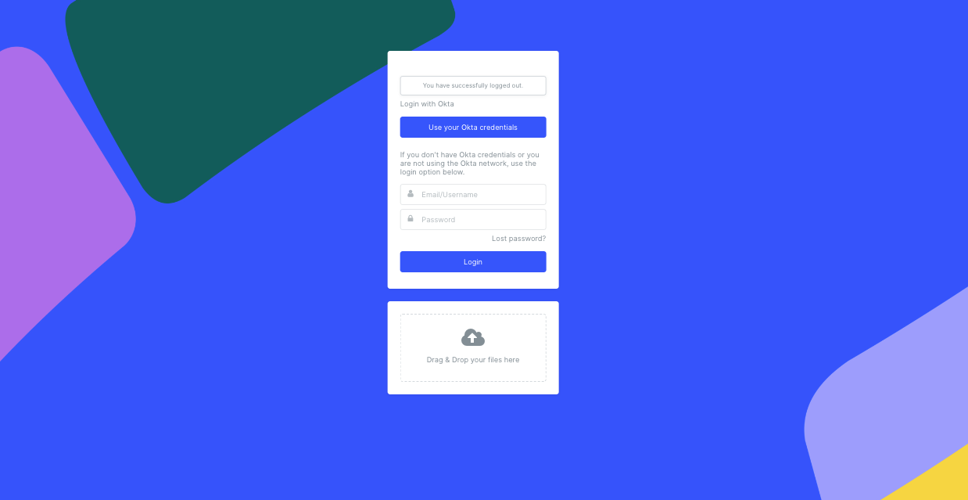
Supported Browsers
You can remove slide from deck if it does not apply to your portal
For the best experience, we recommend using Google Chrome and keeping it up to date with the latest version.
We support the following browsers:
Google Chrome (latest version)
Microsoft Edge (latest stable version)
Firefox (latest stable version)
Safari (latest stable version)
Bynder Compact View

Slide 19
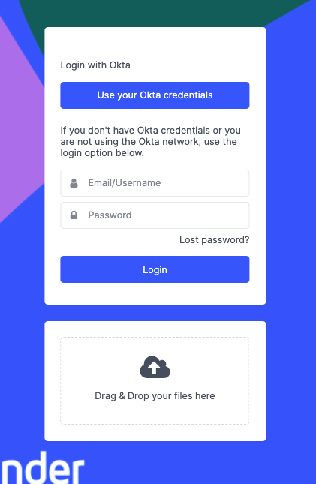
Log in with SSO
Begin by logging in to your Bynder portal using the credentials provided by the organization.
Note: Select the option that best describes your company’s login process.
Navigate to Portal
Select SSO Button
Visit URL
Create Credentials
Sign in Via SSO
Add your portal URL
Click the SSO login button. You will then be automatically redirected to the identity provider (e.g., Okta, SAML, Google).

Slide 20
Log in from Email Invitation
Navigate to your Email
Activate
Create Credentials
Check your email to see if you received a message from your Bynder Admin.
Check your SPAM as this message may have been filtered.
Select Activate Now in the email.
Create a password and enter additional profile details if required.
Use a strong password with a mix of characters. There may be a minimum of characters you need to enter.

Slide 21
Log in by Request Form
Request access to your portal via register a new account button located on your portal homepage.
Depending on your portal setup, you may gain access immediately or need to wait for approval.
Visit URL
Request Access
Receive Email
Create Credentials
Add your portal URL
Select Register a New Account.
Complete all the fields to help provide the Bynder admin with as much information as possible to approve your request.
Once approved, you will receive an email with a link to set up a password for the portal.
Click the link and you will be redirected to the portal.
Create a password and enter additional profile details if required.
Use a strong password with a mix of characters. There may be a minimum of characters you need to enter.

Slide 22
Login Resources
How to log into your portal?
How to Reset Password
Password Policy
Request Access to Bynder via Request Form
Explore your Portal Settings

Slide 23
Training For Light Users
Modify according to how you configured your permissions for light users.
A light Bynder user typically has limited access and permissions tailored for specific, straightforward tasks.
What is a DAM? What is Bynder? Let’s Login Homepage Overview Search for Assets | Save Filters to Save Time Download Assets Share Assets Bynder Express
Ideal For:
Team members needing access to assets for simple tasks without delving into asset management or administrative responsibilities.
Marketing, sales, HR, IT, external vendors, occasional collaborators

Slide 24
Training For Regular Users
Modify according to how you configured your permissions.
A regular Bynder user typically has more access and permissions than a light user, allowing them to manage assets, collaborate, and work closely with the Admin.
What is a DAM? What is Bynder? Let’s Login Homepage Overview Search for Assets Save Filters to Save Time | Download Assets Share Assets Bynder Express Why Metadata Matters Uploading Assets Editing Assets Advanced Rights
Ideal For:
Marketing Team members
Graphic Designers
Content Creators

Slide 25
Homepage Overview

Slide 26
Your Homepage
The homepage, often referred to as the dashboard, is the central hub of your Bynder portal. It’s designed to give you quick access to essential features and content.
Stay updated with important information shared by your admin, including announcements and helpful external links. Think of the homepage as your starting point in Bynder—your go-to place for navigating the portal and accessing relevant content.
Take a look around and explore!
Add Screenshot of Portal Homepage
The experience with the Homepage may vary based on permission settings.
Include a screen recording of your portal homepage and highlighting specific helpful information.
Bynder Compact View

Slide 27
Search for Assets

Slide 28
Search
Ways to search for assets include:
Search bar
Filters
Search bar + filters
Similarity Search
Search by Image
Text-in-Image Search
Search Using Facial Recognition
Add Screenshot of Portal
Customize this page if you plan to use AI Search features, such as Similarity Search.
Bynder Compact View

Slide 29
Let’s Try Searching!

Slide 30
I want to find…
Image of person wearing headphones
for a product launch
Customize this scenario based on the assets in your DAM

Slide 31
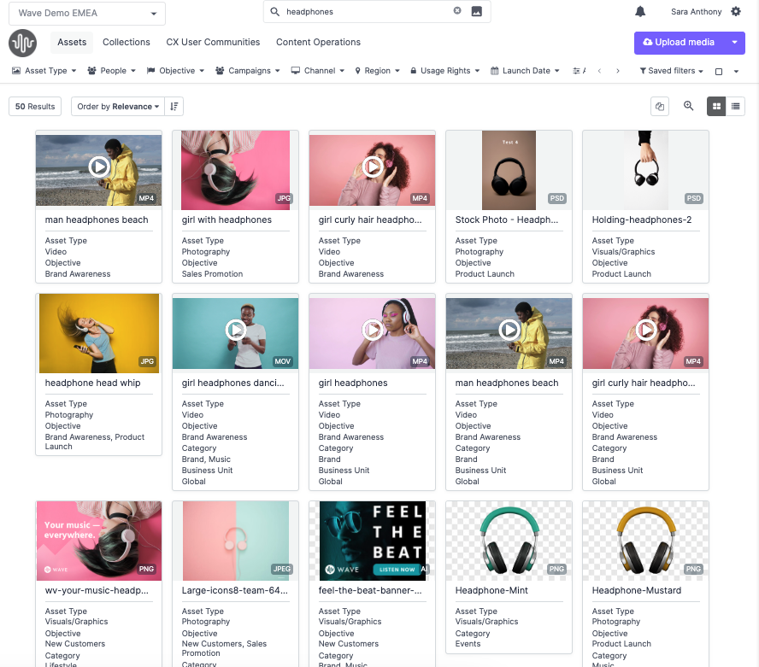
Keyword Search
Type Headphones in the search bar.
Click enter.
Notice that Headphones remained in the search bar.
Important to Note:
Your results may be different than the person next to you, depending on your visibility restrictions.
If you feel that should see an asset or assets that you do not, please contact your Portal Admin.

Slide 32
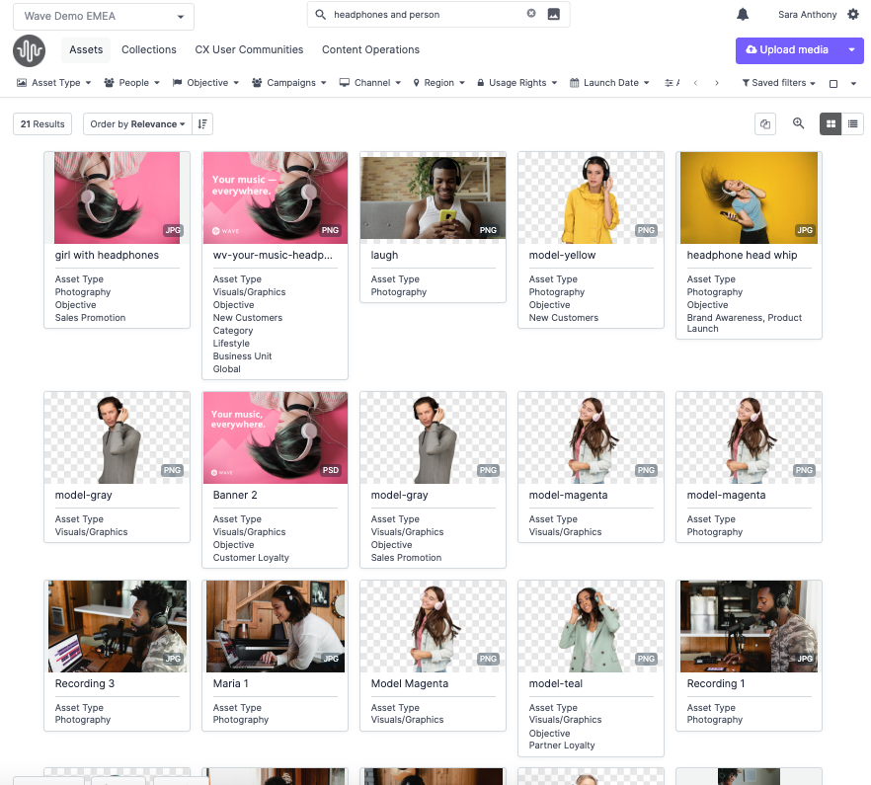
Search by Boolean Search
You can specify your search by using boolean operators.
Type "Headphones and Person"
Type “Headphones or Person”
Type “Headphones on Person”

Slide 33
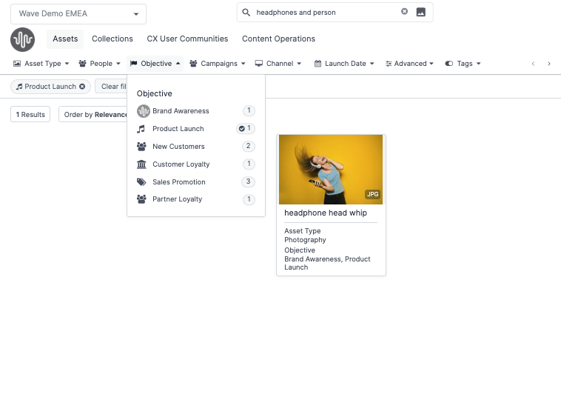
Refine with Filters
What are Filters?
Filters in the Asset Tab help you refine your search and quickly locate the right assets.
Types of Filters
Asset Type
People
Objective
Campaigns
Channel
Customize list of filters based on what you have enabled in your portal - this is based on your whether or not you enabled certain metaproperty types to be added to the smart filter.

Slide 34
Search using Keyword + Filter
Use the filters in the main toolbar to refine and curate your asset selection.
After typing in headphones and person you can tailor your search result and select from the objective filter and select product launch which will narrow your search even further.
If there a specific person you are looking for that is wearing headphones you can select from the people filter and select the persons name.

Slide 35
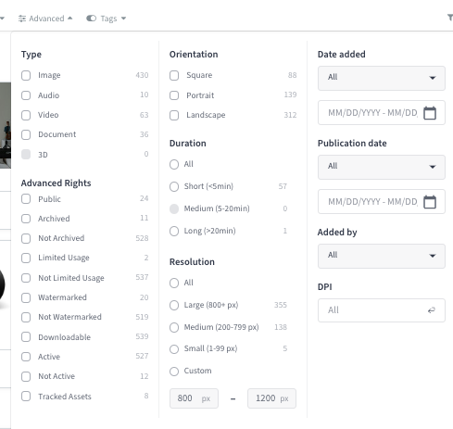
Search for Assets with Advanced Rights
Filtering by advanced rights allows you to quickly find assets that are accessible and free of restrictions, such as being archived or watermarked. This saves you time by eliminating assets that can’t be used, ensuring efficient and accurate asset selection.
For example, if you're looking for an asset without limited usage, you can confidently select it, knowing there are no legal restrictions on its use.

Slide 36
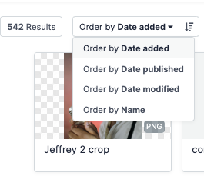
Sort Results
Take it a step further to ensure you find the most relevant asset by sorting your filtered results.
You can sort by:
Date added
Date published (when the asset was created or taken)
By default, assets are sorted by Date Published from newest to oldest
Date modified
Name
Tip: Use the arrow icon to toggle between ascending and descending order.

Slide 37
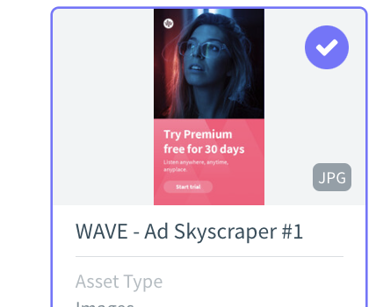
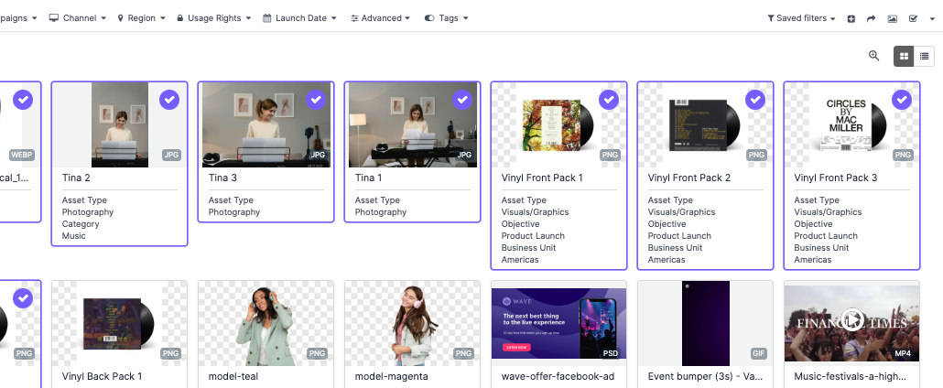
Select Results
After completing your search, you can select assets to download or add to a collection.
Click the checkbox in the top right corner of each asset.
Click and drag your cursor over multiple assets.

Slide 38
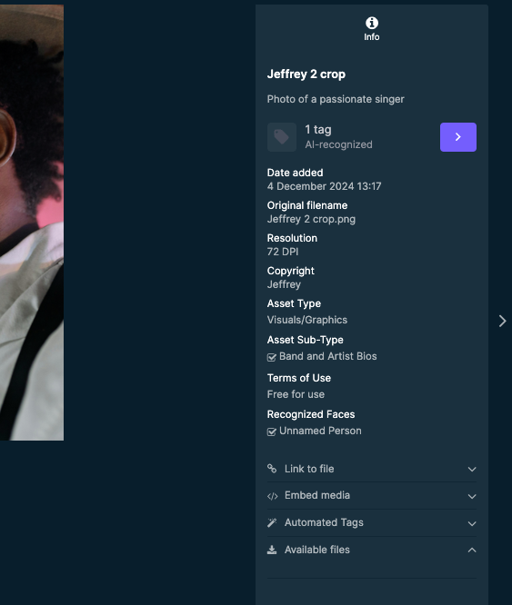
Preview Assets
Some information that appears in the Asset Detail View is dependent on the user’s permissions.
After selecting an asset, click on it to quickly preview and access it.
The this overview is called the Asset Detail View. Here you can see:
Date added
Resolution
Asset Type and Subtype
Terms of Use (if applicable)
Link to file for internal sharing
Available files for downloading (if applicable)

Slide 39
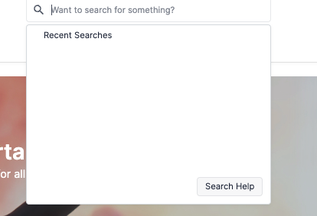
Tips for Searching
Before starting a new search in the search bar, ensure you clear (X) any existing filters.
Clicking on the search bar will show your recent searches.
Select Search Help at the bottom of the search results list for more information on search operators and accessibility.
You can search for assets, collections, guides, chapters, and pages.

Slide 40
Save Filters to Save Time
During training, have each user save a search to their personal filter.
As an admin, you can assign this permission (Create personal asset bank filters) to all Bynder users or specific profiles, allowing them to save filters to their personal filter list. (good for light users)
You can also grant a regular user the permission to create filters that can be shared in the Asset Bank, making the filter visible to all users.

Slide 41
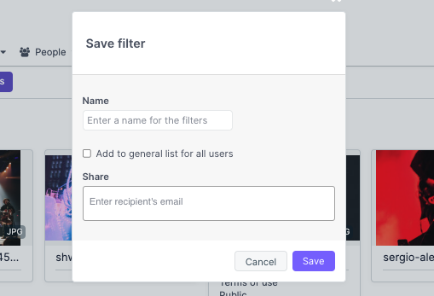
Save Filters to Save Time
Save frequently used searches as filters for quick access. Saved filters capture search terms and applied filters.
For instance, if you often need to access assets for a specific brand campaign, you can save a filter to quickly retrieve those assets whenever needed.
Shared filters may show different asset counts for others due to permission restrictions, as they always respect admin-set visibility rules.
Saved filters are personal and will only appear in your Asset Bank. However, you can share them with other Bynder users.

Slide 42
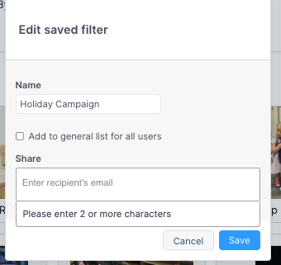
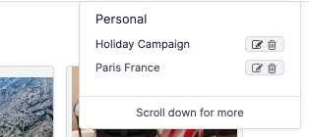
Share Saved Filters
Once you’ve created and saved a filter, you can share it with other Bynder users.
Navigate to Personal Filters > Edit.
Type in the email or username to share the filter.
If you choose to email, the recipient will receive an email and must login. [They must have a Bynder account to access.]
Click Save.

Slide 43
AI Enhanced Search
Duplicate Finder during Upload
Duplicate Finder in the Waiting Room
Natural Language Search (NLS)
Search by Image
Similarity Search for Image Assets
Speech-to-Text for Video and Audio Assets
Text-in-Image Search
If you do not have the AI Search Experience enabled, contact your Customer Success Contact to learn more and the associated costs.

Slide 44
Search, Sort & Select Resources
Search for Assets in Asset Bank
Use Filters to Search
Create Personal Filters
Share Personal Filters
Manage Personal Filters
Optimize Search with Search Bar
Sort Assets
Select Assets
View Assets
Exploring Asset Detail View

Slide 45
Download Assets
There are a variety of permissions you can enable for users to download certain variations of an asset.
Download original assets - Allows users to download the original uploaded assets and view public links.
Download watermarked assets directly - Allows users to download watermarked assets without approval.
Download asset additionals - Allows users to download and view additional files
Download archived assets - Allows users to download archived assets.
Download limited usage assets - Allows users to download assets marked as limited usage.
Download public asset derivatives - Allows users to download asset derivatives marked as public.
Download non-public asset derivatives - Allows users to download the non-public asset derivatives.

Slide 46
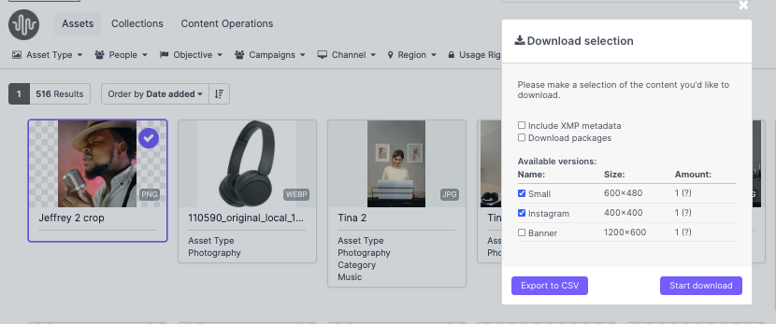
Download Assets
Customize this page depending on if your users can download different derivatives of an asset.
Download the size you need - Bynder instantly transforms the asset into different sizes (derivatives) so we don’t have to store multiple sizes of the same asset
Select one or multiple assets to download at a time.
A download request form might need to be completed before you can download.
Your Bynder Admin controls what each user can and cannot download or any associated derivatives or related files of an asset. If you feel you are missing any of these permissions please contact your DAM Admin.

Slide 47
Download from the Asset Bank
Navigate to Asset Bank.
Click on an Asset or select multiple Assets.
Click the download button that appears in the action toolbar.
If applicable, select the available versions (derivatives) of the asset to download.
Your Bynder Admin controls what each user can and cannot download or any associated derivatives or related files of an asset. If you feel you are missing any of these permissions please contact your DAM Admin.
Customize this page depending on if your users can download different derivatives of an asset.

Slide 48
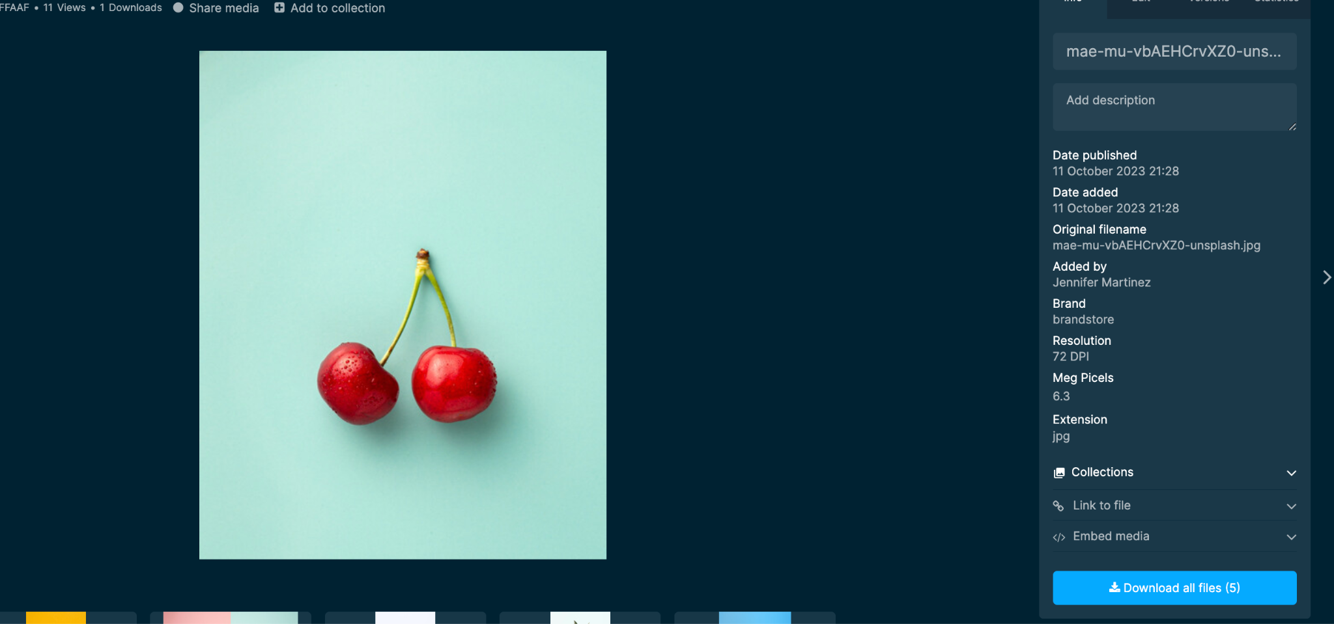
Download from the Asset Detail View
Download an asset from within the Asset Detail View.
Navigate to the Download all files button located at the bottom right..
If applicable, select the available versions (derivatives) of the asset to download.
Your Bynder Admin controls what each user can and cannot download or any associated derivatives or related files of an asset. If you feel you are missing any of these permissions please contact your DAM Admin.
Customize this page depending on if your users can download different derivatives of an asset.

Slide 49
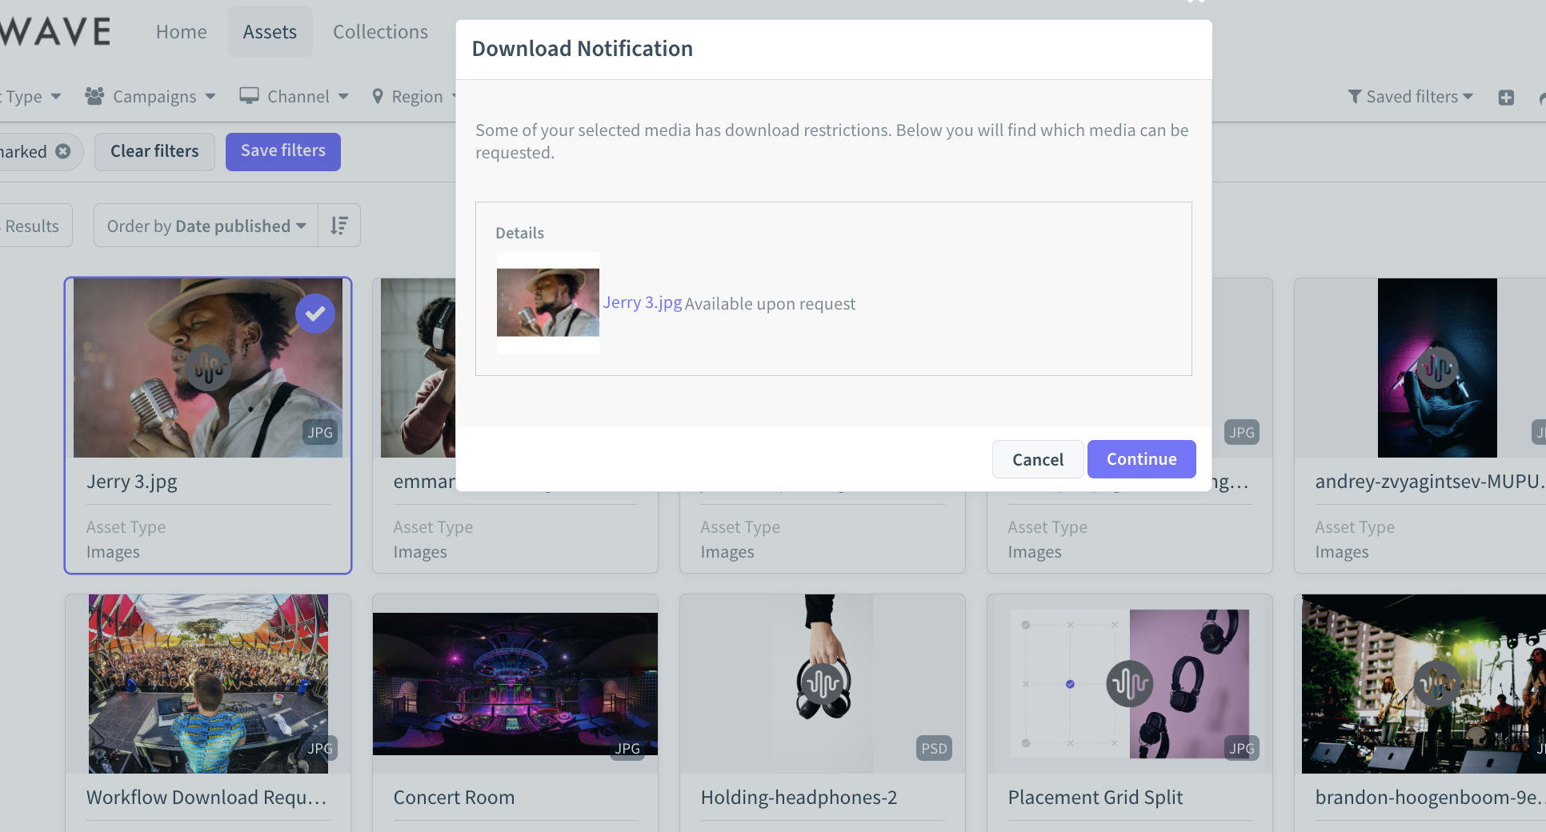
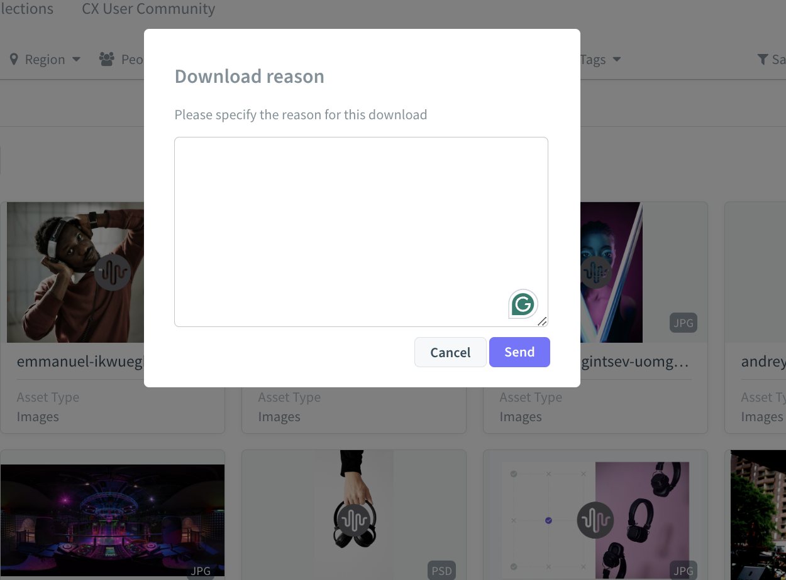
Downloading Watermarked Assets
You may need to grant an agency access to an asset while ensuring they can only download it with a watermark. If an asset is marked with a watermark (configured by your admin), the internal or external user can download it. In some cases, they may need to provide a download reason, which is sent to the admin for approval before the asset can be downloaded.
Customize this page depending on if your users can download different derivatives of an asset.

Slide 50
Download Resources
Download Assets
Download Assets with Request Form
Download Assets with Metadata
Download Derivatives

Slide 51
Share Assets

Slide 52
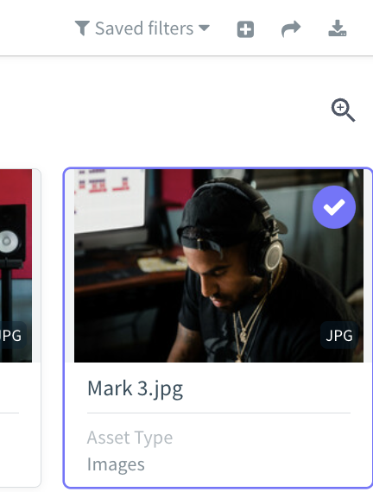
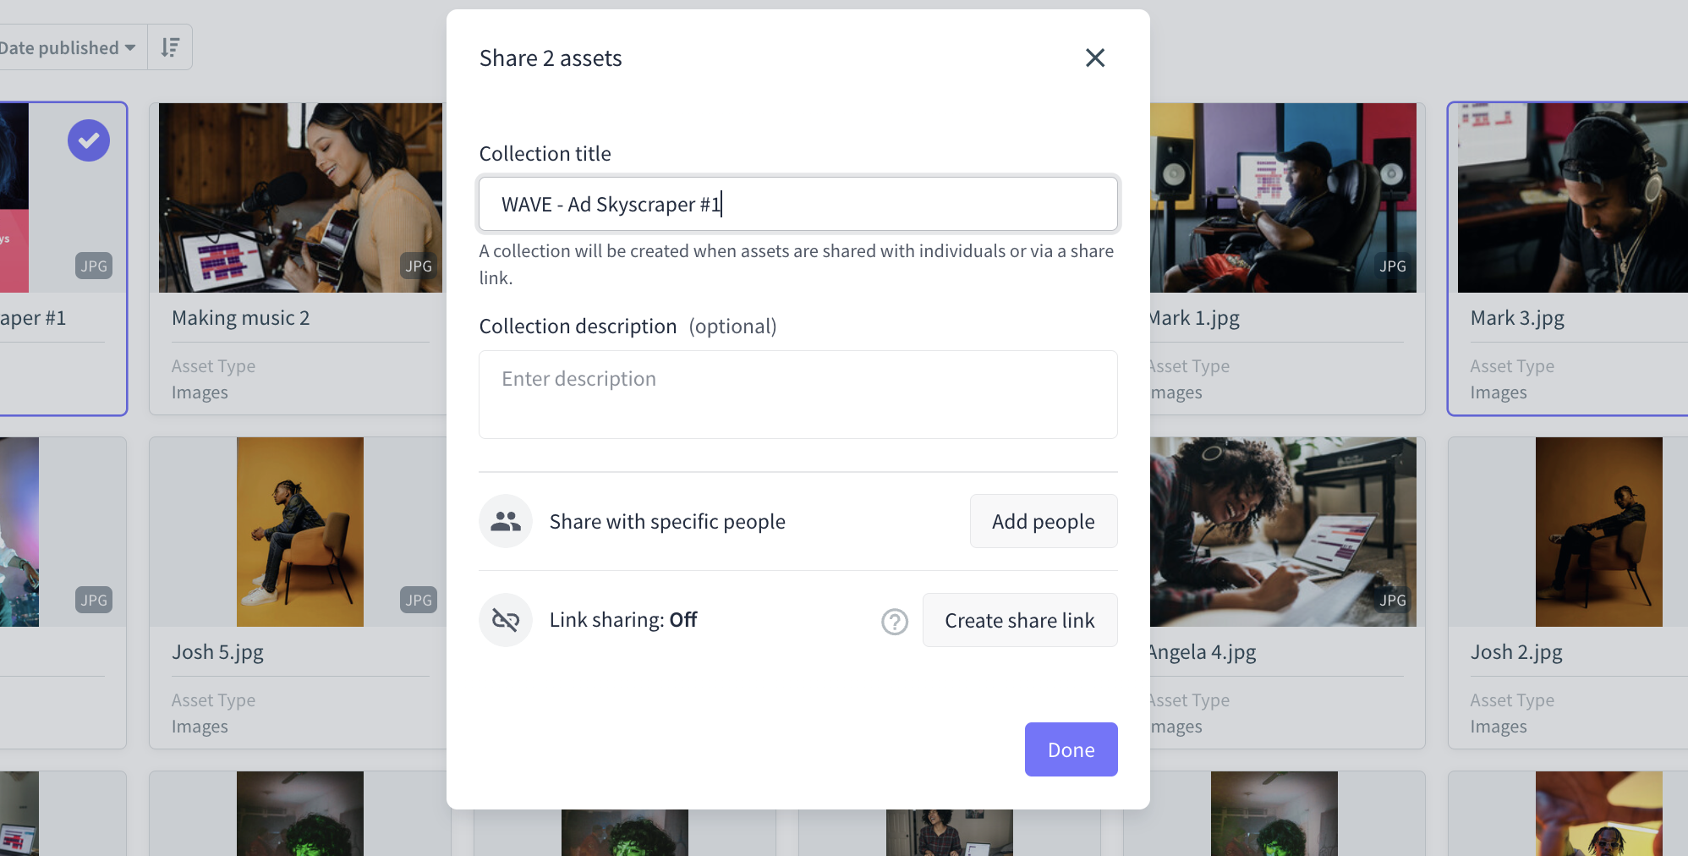
How to Share an Asset with a Colleague
From Asset Bank view
Select the asset you want to share.
Click Share button in the top right.
This will automatically create a collection (even if you’ve selected just one asset).
Include a description (optional).
Add specific people (internal or external).
Select Share Link to create a share link.
Customize this page depending on your users’ share settings.

Slide 53
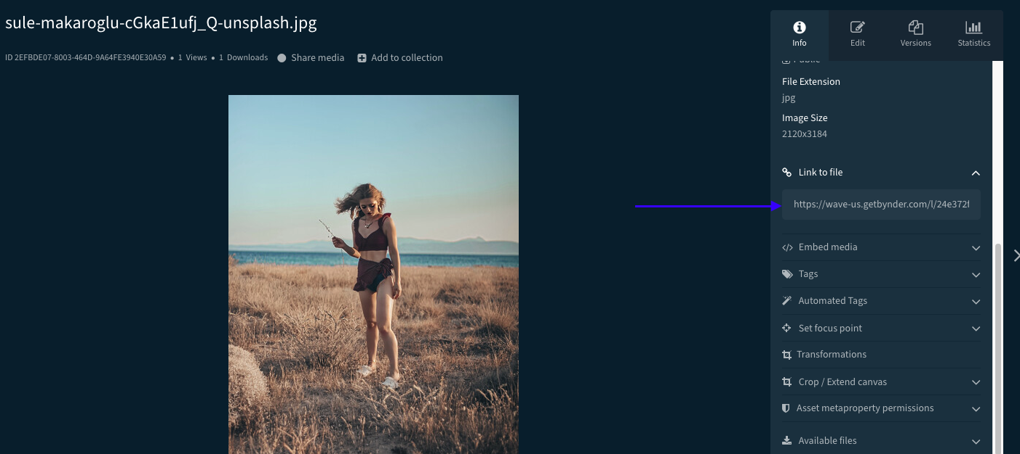
How to Share an Asset with a Colleague
From Asset Detail View
Open the asset you want to share.
Click link to file located in Asset Detail View.
The user must be logged into Bynder to view the asset.
Share the link with the Bynder users.
Depending on their permission they may not be able to see the asset.
Customize this page depending on your users’ share settings.

Slide 54
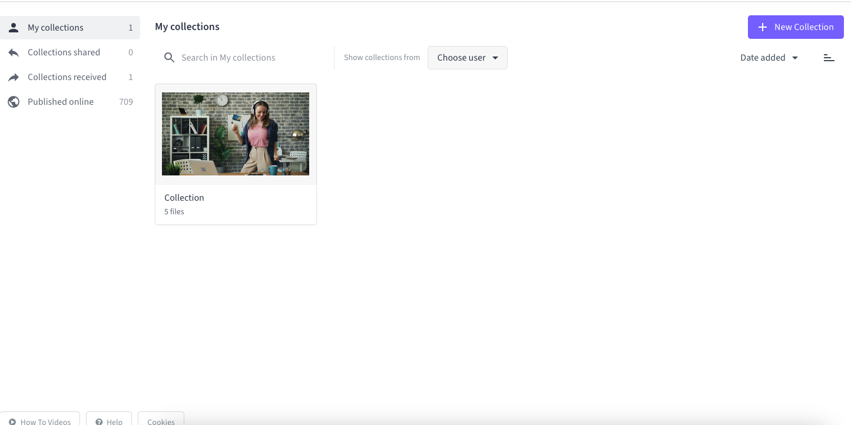
How to Share Assets with External Users
Option 1: Share a Single Asset via Public Link
Use this method when sharing one asset, such as a company logo, that you want the external user to automatically download. The public link is located in the Asset Detail View.
Simply copy the link and share it with the external user.
Option 2: Share a Collection of Assets
Use this method when sharing multiple assets (e.g., a collection of assets for a campaign) with external agencies or partners.
Create + Share the Collection link to provide access to all included assets.
Customize this page depending on your users’ Collection settings

Slide 55
What is a Collection?
A Collection is a curated group of assets that can be organized and managed collectively. Designed to streamline workflows, Collections make it easy to categorize, share, and access assets, whether within your Bynder DAM or with external users.

Slide 56
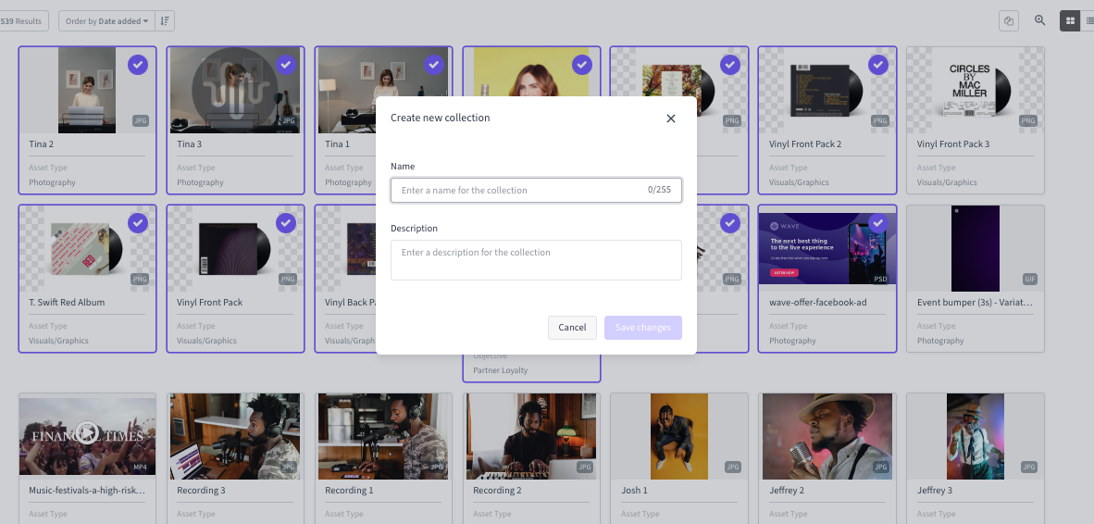
Create a Collection
Requires Create collections enabled in permission profile.
Navigate to the Asset Bank.
Search or filter for the assets you want to add to the collection.
Select them and click Add to Collection in the actions toolbar
Choose to add to an existing Collection or create a new one.
You can always create a new collection in the Collections tab first.
Note: You can customize the user permissions, such as allowing the user to download the assets, view them, or download the assets with a watermark applied.

Slide 57
Tips for Creating and Sharing Collections
Define the purpose for your Collection.
Give Collections a clear and descriptive name.
If you are sharing a Collection with an external user vs an internal user make sure you adjust the permissions accordingly.
If you want to have others collaborate on the Collection with you make sure that they have permission set to do so.
Update Collections regularly.

Slide 58
Share Resources
How to Share Assets
Create Collections
Share Collections
Manage Collection Permissions
Share Files Via Bynder Express

Slide 59
Bynder Express

Slide 60
Share Files via Bynder Express
Include a screenshot of where you chose to locate your Bynder Express
Bynder Express allows you to quickly share large files (up to 40 GB) secure via email or link without uploading to the Asset Bank.
Recipients can download files without logging in, streamlining file transfers while keeping DAM content unaffected.
Files shared via Bynder Express are not uploaded to the Asset Bank and do not require a login to download.
The files count towards your contracted DAM storage until the link expires.
Users with Access to Bynder Express can send files via Bynder Express

Slide 61
Share Files via Bynder Express
Include a screenshot of where you chose to locate your Bynder Express
Locate Bynder Express (this may vary depending on where your admin choose to locate).
Click Share your files or drag and drop the files you wish to share into the Bynder Express box.
Choose Sharing Method.
Select either the Email tab or the Link tab to choose your preferred method of sharing.
(Optional) Add a message for the recipient.
Choose an expiration date for the link (24 hours, one week, one month, or no expiration).
Click Send.
To allow your users to access their personal transfer history and view a record of the files they previously transferred, you need to enable the View Personal Transfer permission.

Slide 62
Why Metadata Matters

Slide 63
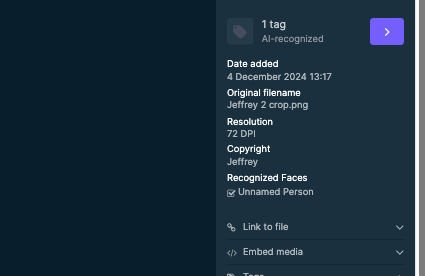
What is Metadata?
Metadata is information that provides details about an asset’s data. Think of it as keywords or tags. It encompasses technical details (e.g., file size, resolution, file format), administrative information (e.g., asset owner, permitted uses), and descriptive data (e.g., location, product, or campaign).
Take the guesswork out of finding, accessing, and using assets, saving you time and effort every step of the way.

Slide 64
Simplifies Searching
Helps find what you need faster. When assets are tagged with clear, descriptive metadata, you can search using relevant terms instead of digging through complicated folder structures.
Unlike folders—where assets can only live in one place—metadata allows assets to appear in multiple searches, making it much easier to locate what you’re looking for. This is the magic of Bynder!
Streamlines Access
Metadata gives you access to the assets you need—no more, no less. This makes it easier to focus on your work without distractions, ensuring you always have the right content to get the job done!

Slide 65
Metadata Resources
What is Metadata
Create Custom Metadata Fields
What is a Tag?

Slide 66
Uploading Assets

Slide 67
Which Method is Right For You?
No matter the method, uploading involves two components: applying the relevant metadata and storing assets in Bynder.
Front Uploader
External Uploader
Mass Uploader
Integrations & APIs
The most common way to upload assets to the DAM. Add one-off assets or drag and drop up to 250 assets at a time!
For people who don’t have access to our DAM like freelancers or agencies. This allows them to send assets to our DAM that require approval before uploading.
When you need to upload more than 250 assets at once that have different metadata.
Automates the upload/download process directly from external systems, such as PIMs, CMS platforms and Adobe CC.
Depending on how you’ve configured your permissions, regular users can upload directly to the DAM, while light users can be given permission to upload with admin approval.

Slide 68
Front End Uploader
You must have Upload assets permission enabled in your permission profile

Slide 69
Upload Files
This text may be different in your portal - if so, replace with relevant text.
Replace image with a screenshot of your portal
Drag and drop your files into the front-end uploader or click the upload media area to browse and select files from your device.
You can only drag and drop files when you are in the Assets tab.

Slide 70
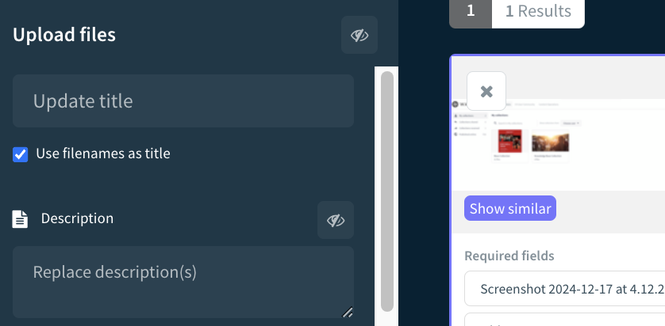
Set the Asset Title
Use the original file name as the asset title (this appears under the thumbnail in the Asset Bank).
or
Add a custom title by entering text in the Title field.

Slide 71
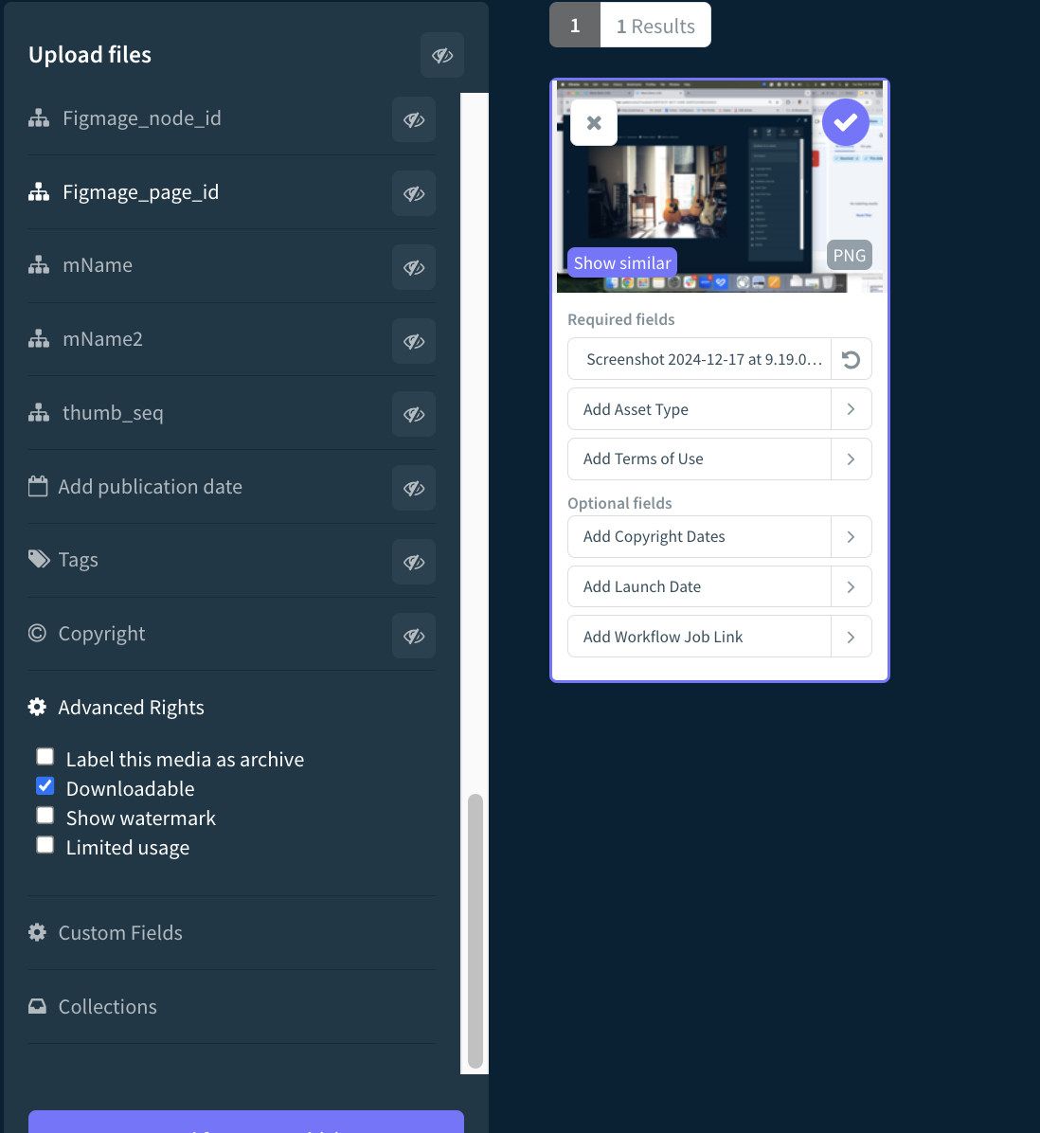
Fill in Required Metaproperties
Fill in Required Metaproperties
Look for metaproperties marked with a red asterisk (*). These fields must be filled out in order to upload the asset.
Fill out as much metadata information as possible.
Comprehensive metadata ensures assets are easy to search and find later.
In the Advanced Rights section, you can specify whether the asset should be downloadable, have a watermark applied, be archived at a certain time, or have restricted usage.

Slide 72
Methods of Adding Metadata
Add Metadata in Bulk (Recommended)
Use the left sidebar to add metadata to multiple assets at once.
Your selections in required metaproperties will automatically appear in the corresponding white fields under each asset thumbnail.
Add Metadata Individually (Optional)
If necessary, edit metadata for individual assets by entering information directly into the white fields below each asset thumbnail.

Slide 73
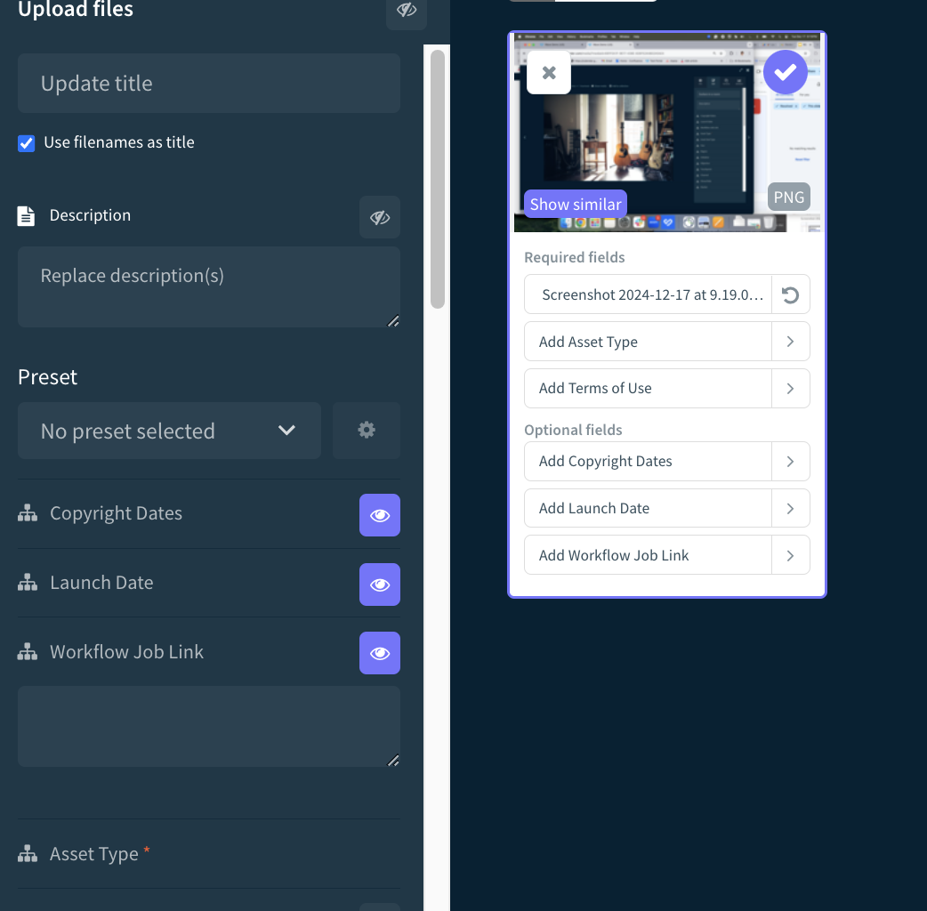
Optional Metaproperties
Metadata selections made in the sidebar for optional metaproperties will still apply to your selected assets.
To see optional metadata appear in the white fields under the thumbnails, click the eyeball icon next to the relevant metaproperty in the sidebar.

Slide 74
Store Files and Complete Upload
Once you’ve added all the appropriate metadata, click Store selected files or Send for approval at the bottom left corner of the screen.

Slide 75
Create a Preset to Save Time!
Before saving your upload, you can add any additional metadata and select a preset to streamline future downloads. Here's how:
Click the dropdown menu under Preset.
Select Create new preset.
Name your preset and save it for future use.
Keep in mind that you must save the assets to the DAM for the preset to be stored. Once saved, your preset will be available for reuse, making your workflows faster and more efficient

Slide 76
Tips for Front End Uploader
Upload similar assets in batches (e.g., photos from one event, campaign branding, or department documentation) to streamline metadata tagging and bulk actions.
Start at the top of the sidebar and work down to ensure automations run correctly.
Metaproperty selections apply only to selected assets. Ensure the checkbox at the top right is checked before applying metadata and submitting.
Submit assets to the DAM to save a preset.

Slide 77
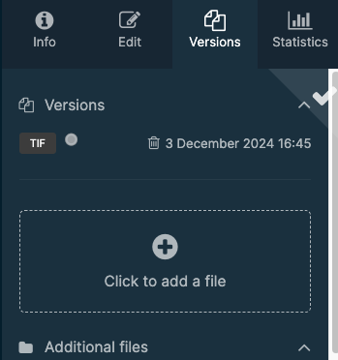
Upload a New Version
Users need to have Edit Permission to upload a new version.
Bynder allows you to keep your assets up-to-date by seamlessly replacing outdated versions, reducing clutter, and grouping all versions together for easy access.
Click the asset you want to update.
Select the Versions tab.
Click + (or drag and drop the new version into the upload area).
Select the updated file from your device.
The new version will be uploaded and automatically activated. You may have to refresh your browser's page to see the changes reflected.
If you want to upload new versions to existing assets in batches, use the Mass Version Updater.

Slide 78
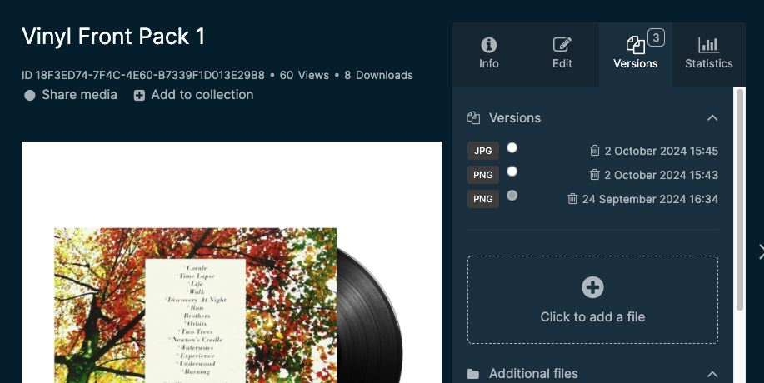
View Version History
You need to have Edit Permission to access this page.
The Versions tab allows you to access the version history, compare changes, and, if you have the appropriate permissions, restore previous versions.
Keep in mind that you cannot view a previous version directly unless you set it as the primary version in the portal.
Replace image with a screenshot of your portal

Slide 79
External Uploader

Slide 80
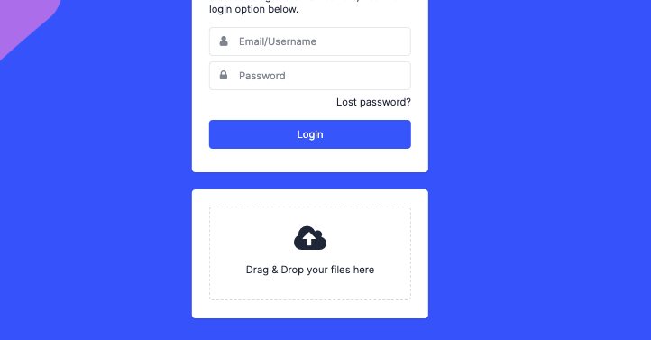
External Uploader
This text may be different in your portal - if so, replace with relevant text.
Replace image with a screenshot of your login page.
Allows anyone, even those without Bynder accounts, to upload assets directly from the DAM login page—ideal for external freelancers and agencies.
All uploads are subject to admin review before being added to the Asset Bank.
While uploaders cannot add metadata, the approving admin will complete the required metadata fields once the assets are approved.

Slide 81
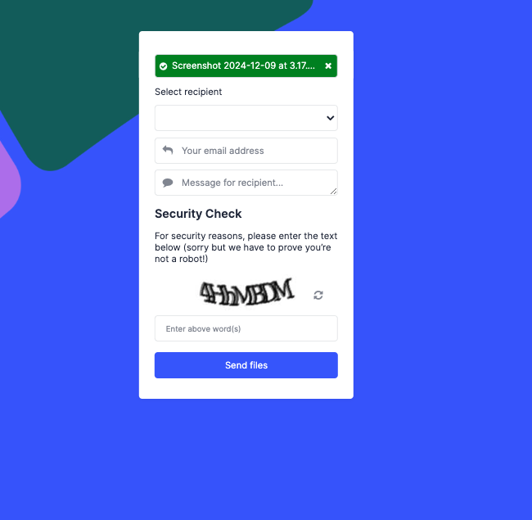
How to Upload Assets via External Uploader
*This can be converted into a dropdown menu, allowing you to select a specific admin or user as the recipient.
Select or type the name of the asset recipient* (the recipient must have an account in the portal).
Enter your email address.
Add an optional message.
The message field is the only place where you can include contextual information about the files being uploaded.
Users will be asked to review the assets or take further action if required.
The recipient will receive a notification once the assets are either added or approved, depending on the portal’s configuration.

Slide 82
Mass Uploader
The mass uploader is accessible to anyone with upload permissions.

Slide 83
Mass Uploader
The mass uploader is an alternative to the front-end uploader, designed for handling batches of more than 250 assets. Metadata is applied through a CSV file, which is uploaded alongside your assets. Bynder matches the CSV metadata to the assets based on their file names.
Check with your Customer Success Contact or Onboarding Manager to see if the mass uploader is included in your contract.

Slide 84
Setting up your Mass Upload Batch
Once the mass uploader is configured, you'll receive a CSV template to set up your upload batch. The columns must remain in the same order, with no additions or deletions, though not all columns are mandatory.
Open the CSV in Google Sheets or Microsoft Excel.
In Column A, paste the list of asset file names you want to upload.
Type or paste the relevant metaproperty information into each corresponding column.
For multiple options in a single metaproperty, separate them with commas (e.g., “option 1, option 2”).
Ensure metaproperty options are spelled correctly to avoid errors. Incorrect spelling will cause errors during upload, and these incorrect metaproperties will be added to the DAM, making assets harder to find.
Next, follow these steps to upload:
Log into Bynder, hover over your name, and select Mass Uploader.
Drag and drop your formatted CSV file into the top-left corner of the page.
Once the CSV processes, drag and drop your assets into the lower-left sidebar.
Wait for the assets to be marked as successful. Do not leave the page until all assets have fully processed (you can open another tab to continue working).
If any assets fail to process, re-upload them.
Depending on your portal setup, the mass uploader may either add unrecognized values as new options in a metaproperty or return an error message. Contact your CSM or Onboarding Manager to learn how your portal is configured.

Slide 85
Tips & Tricks for Using the Mass Uploader
Mimic Dropdown Menus: The mass uploader doesn’t provide dropdown options like the front-end uploader. To replicate this, apply data validation rules in Excel or Google Sheets to ensure consistent entries.
Required Fields: The uploader doesn't enforce required fields automatically. Check with your admin to understand which fields are mandatory. Use formatting (highlighting, bold, changing text color, etc.) to visually mark required fields according to your DAM program’s policies.
Be Careful with Column Modifications: You can hide unnecessary columns, but avoid deleting, adding, or reordering columns. Changing the structure will make the uploader unrecognizable to the system, causing errors during the upload process.

Slide 86
Uploading Assets Resources
Best Practices for Uploading, Editing, and Deleting Assets
Supported File Types for Upload and Preview
Upload Assets as a Logged-in User (Front End Uploader)
Create and Apply Metadata Presets During Upload
Upload Assets as an External User (External Uploader)
Upload Assets via Mass Uploader
Mass Version Updater
Upload New Version of an Asset

Slide 87
Editing Assets
Users with edit assets permission can edit assets

Slide 88
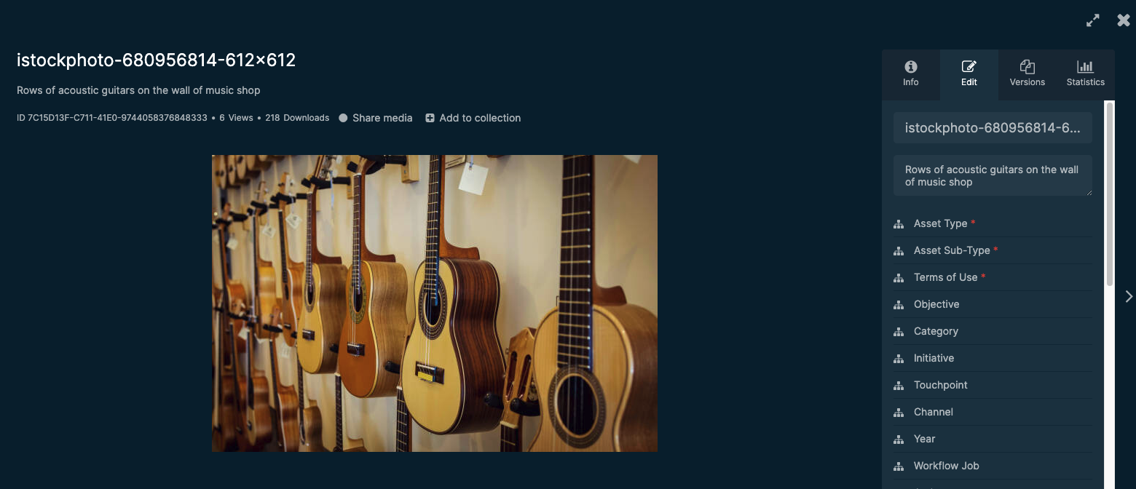
Editing Assets
Edits can be made to assets individually or in bulk.
Editing refers to modifying the asset metadata, not the file itself.
Access to editing is permission-based, and some fields may not be editable depending on your DAM’s setup.

Slide 89
Editing a Single Asset

Slide 90
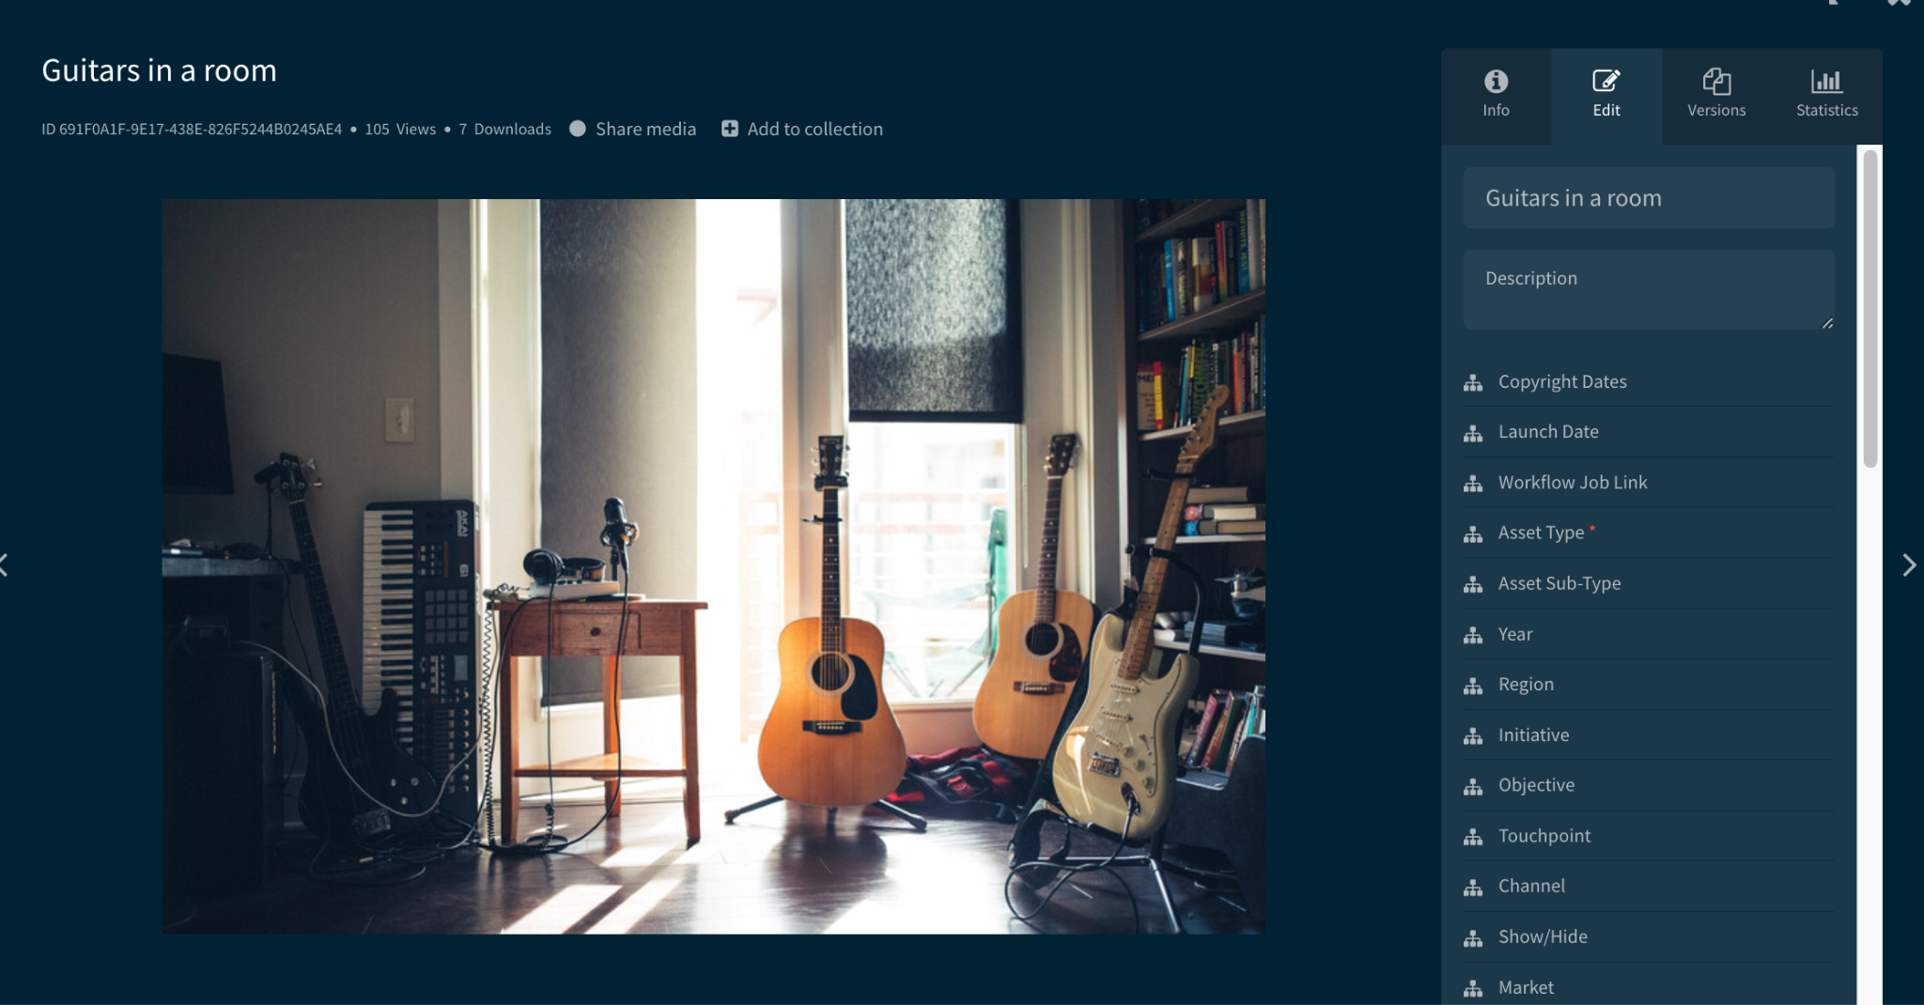
Editing a Single Asset
Click the asset that you want to edit.
Select the edit tab.
Edit the title, description, metaproperties, tags, and more as needed.
Click Save.

Slide 91
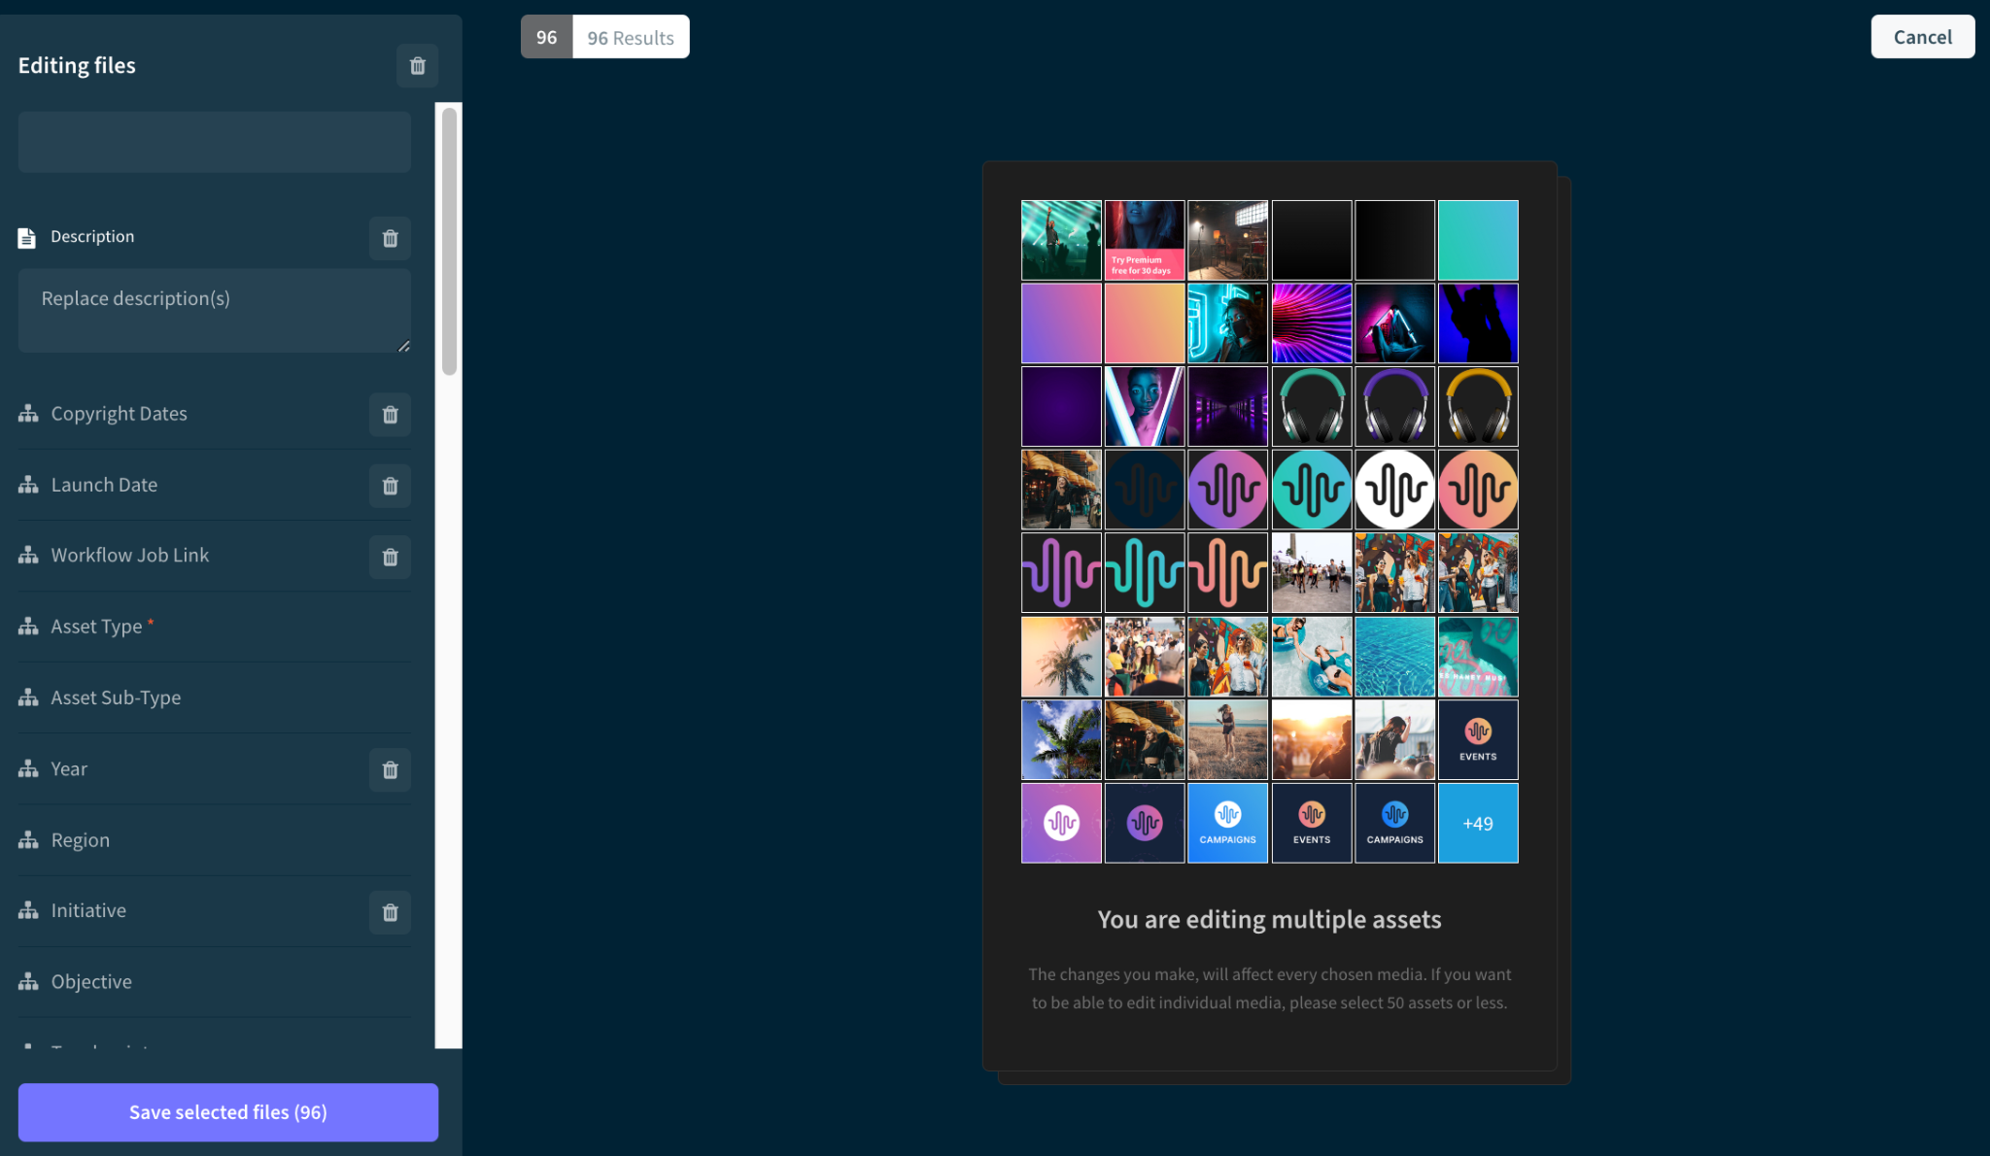
Best Practices for Edit Multiple Assets
Group Similar Assets: For the best results, select assets with similar metadata. Changes made to the metadata of one asset will apply to all selected assets.
Bulk Editing Limit: You can bulk edit up to 1,500 assets at once. Be mindful of this limit when selecting assets for editing.
Use the Bynder API for Large Edits: If you need to edit more than 1,500 assets, consider using the Bynder API for a more efficient process.
Preview and Single-Asset Edits: Previews and single-asset edits are only available when editing fewer than 20 assets at a time. For larger edits, consider working with batches under this limit for a smoother experience.

Slide 92
Editing Multiple Assets
Select the assets you want to edit by either clicking the checkbox in the top right corner of each thumbnail or dragging your cursor to select multiple assets at once.
Click the Edit Media button that appears in the actions toolbar.
Use the sidebar to edit the metadata for your selected assets.
Click Save to apply your changes.
Note: This process is similar to the upload screen, but dependencies and automations are not initially applied. For example, fields like "Asset Sub-Type" may still appear, even if they are set to be hidden via automation.

Slide 93
Editing Assets Resource
Edit Assets in Asset Bank
Best Practices for Uploading, Editing, and Deleting Assets

Slide 94
Advanced Rights

Slide 95
Advanced Rights
Using advanced rights in Bynder allows you to have more granular control over your assets, ensuring that they are used and accessed according to your specific requirements.
Control Asset Visibility: You can apply restrictions such as watermarking, limiting usage, or archiving, which prevents assets from being accessed or used inappropriately. This is especially useful for assets that need to be protected due to legal, branding, or compliance reasons.
Compliance and Licensing: Advanced rights help ensure that your assets are used in compliance with licensing agreements. You can restrict the access and usage of assets based on certain criteria, such as usage period or the type of license granted.
Granular Permissions: Instead of setting global permissions for users, you can specify advanced rights to particular assets, limiting who can view, download, or share them. This helps ensure that sensitive or confidential assets are only accessible to those who truly need them.
Improve Findability: You can filter out assets that have certain restrictions applied (e.g., watermarking or limited usage). This helps streamline the search process, allowing users to easily find assets that are available for use.
Maintain Brand Consistency: By restricting how and where certain assets can be used (such as not allowing the download of certain branded materials), you ensure that your brand guidelines and visual identity are upheld across all platforms and media.
Track Usage: You can better track how assets are being used, who’s accessing them, and whether any restrictions are being violated. This can be particularly useful for audits or content management purposes.

Slide 96
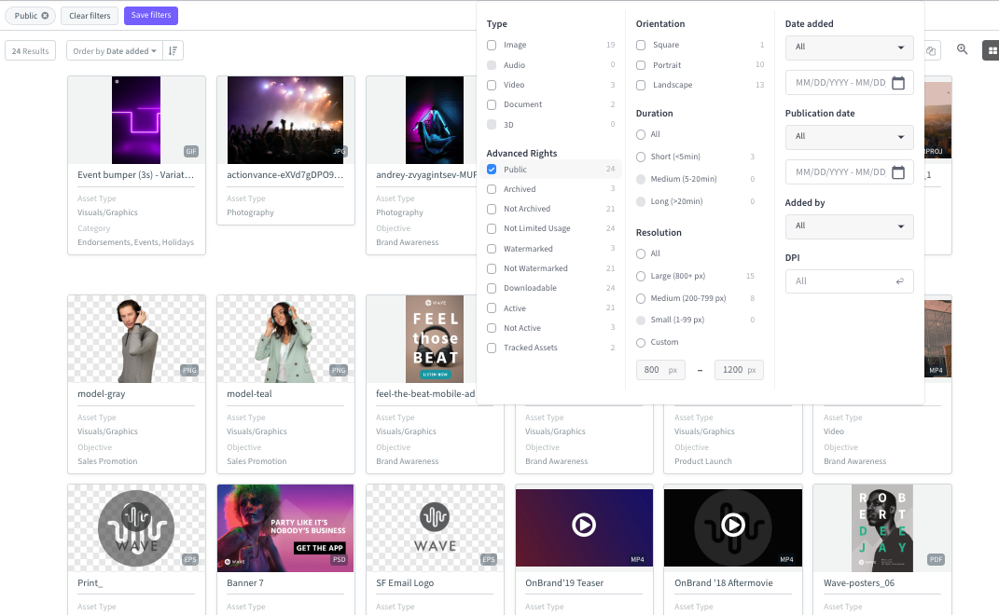
Public Link
Requires Mark assets as public permission.
Once an asset is marked as public, any user can share its public link with external users. These external users will be able to view or download the asset.
Public links can also be used as source URLs on websites and are accessible via the API, making it easy to integrate and share assets across different platforms.

Slide 97
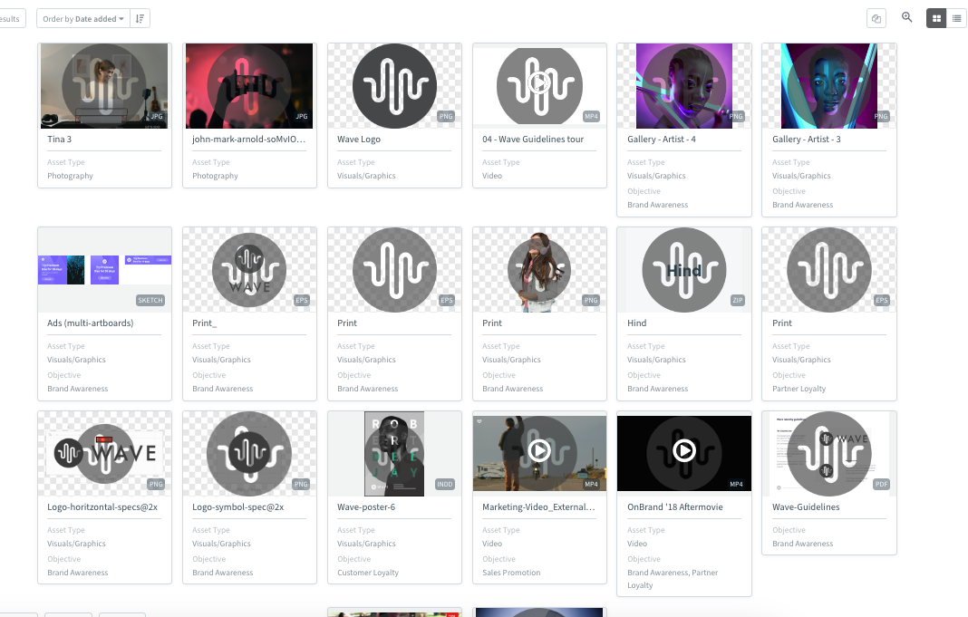
Watermarked Assets
To safeguard your assets from unauthorized use, you can enable the watermark option.
Watermarks act as a visible reminder that the asset is accessible by request only.
If a user attempts to download a watermarked asset, they must submit a request. Access will only be granted if approved by an authorized user, ensuring controlled access and proper usage of the asset.

Slide 98
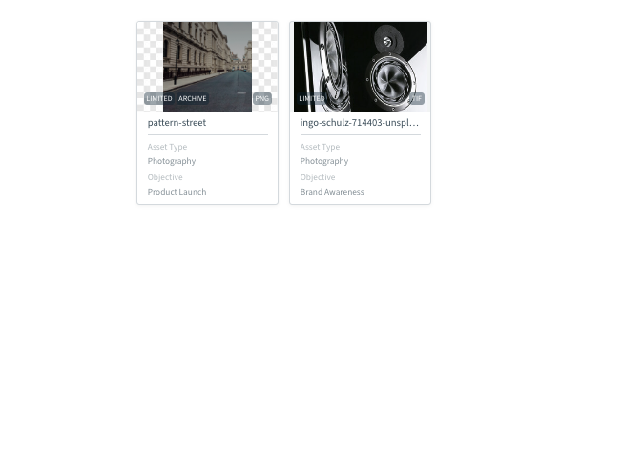
Limited Usage
Users with Upload assets with mandatory approval and Upload assets can set assets to Limited Usage upon upload
Users with Edit assets can set existing assets to Limited Usage.
Mark limited usage for assets that are sensitive or have restricted access due to licensing, confidentiality, or strategic reasons.
[Input your own example]
For example, prototype materials that are only available to executive leadership can only be viewed by those that are part of that group.

Slide 99
Advanced Rights Resources
What are Advanced Rights
Mark an Asset as Downloadable or non-Downloadable
Add Watermark to Your Assets
Remove Watermark from Existing Assets
Limited Usage Assets
Mark Assets Public
Mark Media as an Archive

Slide 100
Thank you!
For any questions please visit support.bynder.com or contact your Bynder Admin

